Slide 1
PUBLIC NEWS APPLICATION

Slide 2
ABSTRACT
An public news application is a website that provides news and information about current events, issues, and other topics of interest. Online news portals typically offer a range of content, including articles, videos, podcasts, and other multimedia formats, and may cover a wide range of topics such as politics, business, sports, entertainment, and more. They are a popular source of information for people who want to stay informed about current events and news from around the world.
Reading news through News paper is not a good solution in this era for news readers. The web World is so fast, there are many websites which provides instant news. The main objective building and developing of Online News Portal to provide instant news to news readers. This website provides information about latest news, articles, education, health tips, breaking news, political, sports, etc. The One more advantage of this project is here advertisers can upload advertising contents through online for website ads. Advertisers have option to make payment through online for published advertisements.

Slide 3
HARDWARE SPECFICATION
Processor : P 4 700 GHz.
RAM : 4 GB RAM
Hard Disk Drive : 180 GB

Slide 4
SOFTWARE SPECIFICATION
Operating System : Windows 7/8/10
Front End : JAVA
Back End : SQL

Slide 5
EXISTING SYSTEM
The existing system of news portal we need to spend money and buying the newspaper. The news paper has only specific number of pages and cannot cover all the news in single paper. Also we need to wait for next day to read the yesterday news
Disadvantages
Waste of paper
Waste of money
Cannot read live news

Slide 6
PROPOSED SYSTEM
This is generally thought of as a Internet connection to a news source but the definition of a “Portal” would include a newspaper, magazine or any other access to news. A web portal is any access point to the Internet.
Advantages
Report news if it is fake
find the latest news
district wise split news

Slide 7
Modules
Upload News : This module used to publish news. Admin or news reader can publish breaking news, latest news, Political, Financial, Sports, etc. Visitors or news readers can read published news content. Advertisements will appear in the right side of the news and articles section.
Admin/News Reader: This module used to publish articles or knowledge base. Admin or news reader can publish articles of education, health tips, movies, story, etc. Visitors or news readers can read published article content. Advertisements will appear in the right side of the news and articles section.

Slide 8
News Reader Registration
This module is used to collect the information about the news reader and save these details to the news reader table. This module also collects the information about the login credentials. Using this credential to login into the application.
News Details
when the admin or news readers are upload their local news video it will be shown to the all the registered users and admin as well. The admin can have provision to delete the videos.
Report News :
If any one of the user view the video and if the video is an vulnerable then the news reader can able to report the news and it will be notify to the admin. Then the admin can able to check the news and block the content.

Slide 9

Data Flow Diagram
Level 0

Slide 10
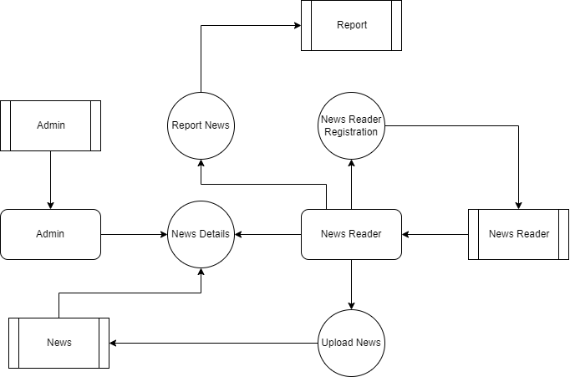
Level 1:

Slide 11
TABLE DESIGN TABLE NAME:ADMIN
FIELD | DATA TYPE | SIZE | CONSTRAINT
Admin id | Int | 10 | Primary key
Username | Varchar | 30 | Not null
password | Varchar | 30 | Not null

Slide 12
TABLE NAME:Category
FIELD | DATA TYPE | SIZE | CONSTRAINT
Category id | Int | 10 | Primary key
Name | Varchar | 20 | Not null
Description | Varchar | 30 | Not null

Slide 13
TABLE NAME:POST
FIELD | DATA TYPE | SIZE | CONSTRAINT
Post id | Int | 10 | Primary key
Post Title | Varchar | 20 | Not null
Category Id | Int | 10 | Foreign Key
Post Details | Varchar | 100 | Not null
Date | Date | 10 | Not null
Post Url | Varchar | 20 | Not null
Posted By | Varchar | 30 | Not null

Slide 14
TABLE NAME:USER
FIELD | DATA TYPE | SIZE | CONSTRAINT
User id | Int | 10 | Primary key
Name | Varchar | 20 | Not null
Email Id | Varchar | 30 | Not null
Username | Varchar | 30 | Not null
Password | Varchar | 30 | Not null

Slide 15
Thank You

